Slide 1
CSC 591 Spatial & Temporal Data Mining Project Presentation
Spring 2020
Dr. Ranga Raju Vatsavai
Spatial Prediction using Satellite Images
Karan Dave (kdave)
Rohan Pillai (rspillai)
Shaival Shah (sshah27)

Slide 2
Outline
Introduction
Motivation
Data Description
Exploratory Data Analysis
Implementation Flow
Tools
Results
Conclusion
Demonstration

Slide 3
Introduction
The purpose of this project is to segment different spatial features from satellite images.
Use U-Net as an architecture by tuning it for spatial data.
Our main addition to the existing architecture is to use weighted loss by using weight maps in order to correct the wrongly predicted pixels and increasing depth of U-Net and adding dropout after tuning.

Slide 4
Related Work
CNN is one of the main supervised approaches that has been tested to work in this domain. The key principle behind the working of these networks is their ability to learn meaningful and right features while being efficient.
Fully Convolutional Network (FCN) is one of the other well known technique. The main idea of this approach is to use a CNN as a powerful feature extractor while replacing the fully connected layers with convolution ones to output spatial maps instead of classification scores
Other techniques that have been used include the use of neural network architectures such as R-CNN and U-NET.

Slide 5

Motivation
Creating and Keeping up-to-date maps.
Urban Planning
We can use this information to understand whether a particular area is developed or not.
Reliable and automated image segmentation for agricultural purposes.

Slide 6
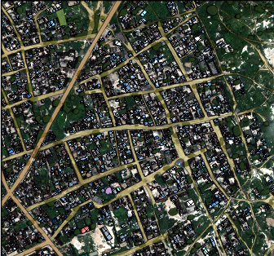
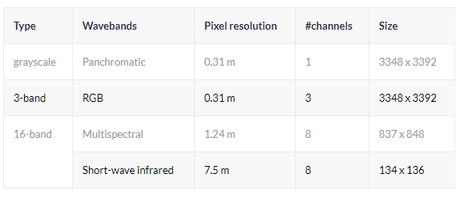
Data
Kaggle Satellite Image Dataset [link]
1km x 1km satellite images
3-band format and 16-band format
10 different labels: Buildings, Road, Track, Trees, Crops, Waterway, Standing Water, Large Vehicle, Small Vehicle, Miscellaneous Structure.
TIFF Images

Slide 7
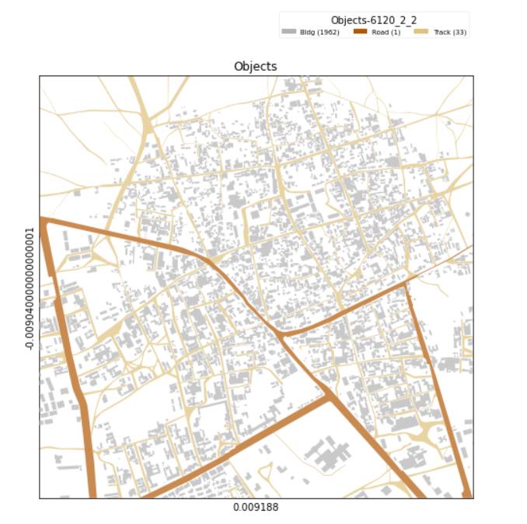

Exploratory Data Analysis
Identified the number of objects in each training image for different classes.

Slide 8
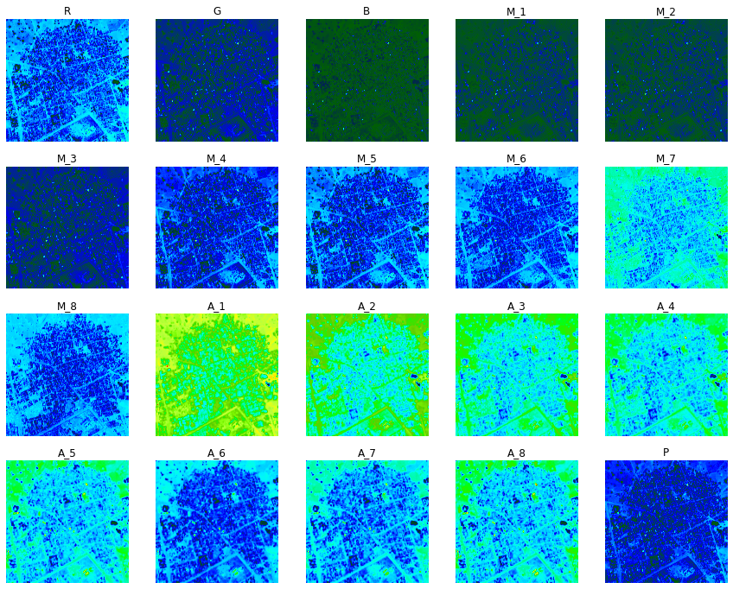

Slide 9
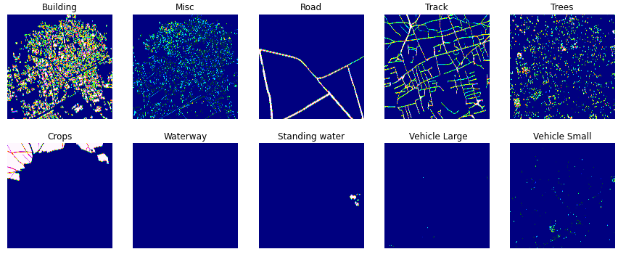
EDA
Masks

Slide 10
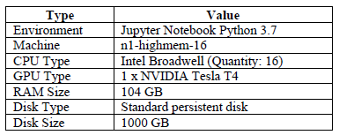
Tools
Used Google Cloud Platform (GCP).
Trained using Keras with a Tensorflow backend.

Slide 11
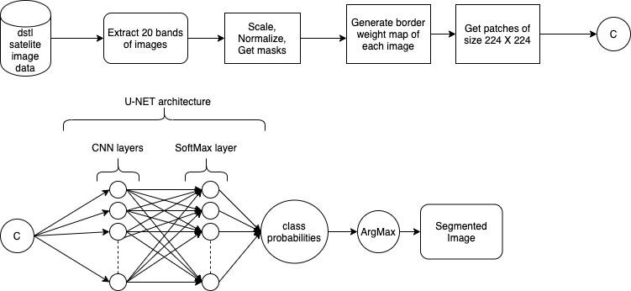
Implementation
Segmentation Pipeline

Slide 12
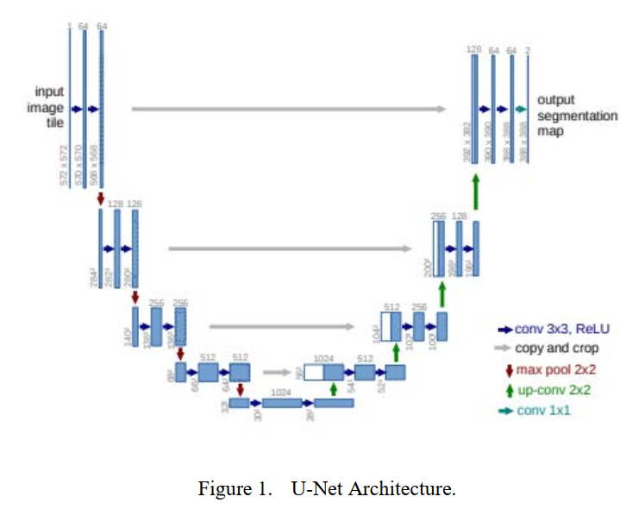
U-NET

Slide 13
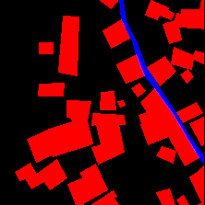
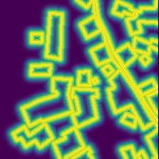
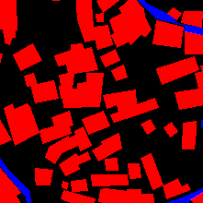
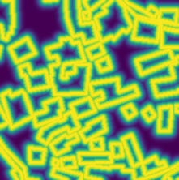
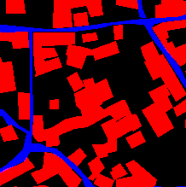
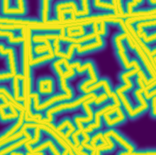
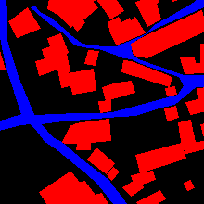
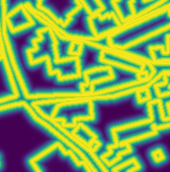
WeightMaps

Slide 14

Results
Use of Jaccard Index (IOU) to estimate accuracy.
Loss function:
Binary cross entropy loss (trained one model for each class).
Optimizer: Adam optimizer.

Slide 15
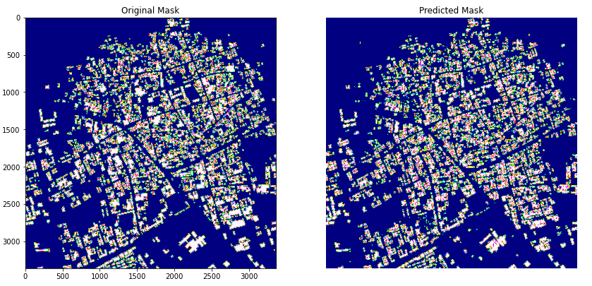
Results

Slide 16
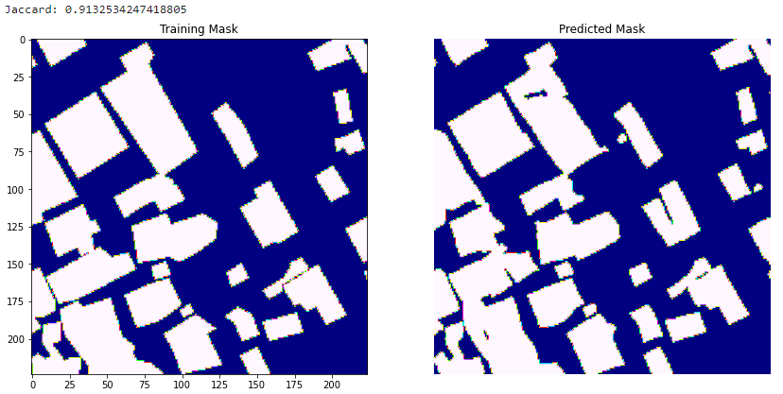
Results

Slide 17
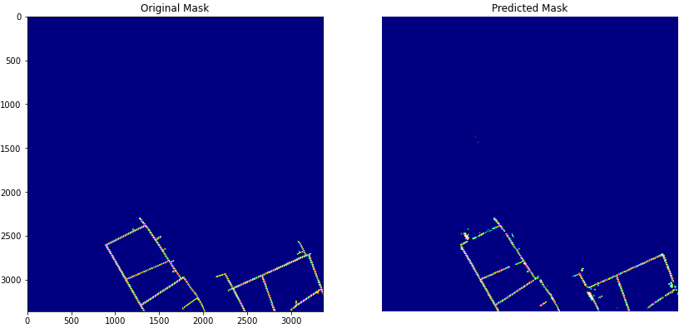
Results
Iglovikov et al.’s Results |  | Our Implementation Results
Class | Accuracy | Class | Accuracy
Buildings | 0.745 | Buildings | 0.721
Road | 0.801 | Road | 0.787
Track | 0.328 | Track | 0.311

Slide 18
Conclusion
Spatial data can be used to extract information out of them.
Existing architectures with appropriate changes are very successful in doing this job.
Scope for improvement:
More hyperparameter tuning.
More data samples for better training.

Slide 19
Thank You

Slide 20
References
Long, Jonathan, Evan Shelhamer, and Trevor Darrell. ”Fully convolutional networks for semantic segmentation.” Proceedings of the IEEE Conference on Computer Vision and Pattern Recognition. 2015.
Everingham, Mark, et al. ”The pascal visual object classes challenge: A retrospective.” International Journal of Computer Vision 111.1 (2015): 98-136.
Ronneberger, Olaf, Philipp Fischer, and Thomas Brox. ”U-net: Convolutional networks for biomedical image segmentation.” International Conference on Medical Image Computing and Computer-Assisted Intervention. Springer International Publishing, 2015.
Iglovikov, Vladimir; Mushinskiy, Sergey; Osin, Vladimir. "Satellite Imagery Feature Detection using Deep Convolutional Neural Network: A Kaggle Competition". CoRR. abs/1706.06169. (2017).
World View-3 Satellite Sensor Specifications. http://www.satimagingcorp.com/
https://medium.com/vooban-ai/satellite-image-segmentation-a-workflow-with-u-net-7ff992b2a56e.
https://deepsense.ai/deep-learning-for-satellite-imagery-via-image-segmentation/.

